Slide 1
Pizza Portal
Ankit Joshi, Chirag Jain, Pranay Reddy, Shubhi Jain, Vinay Kumar

Slide 2
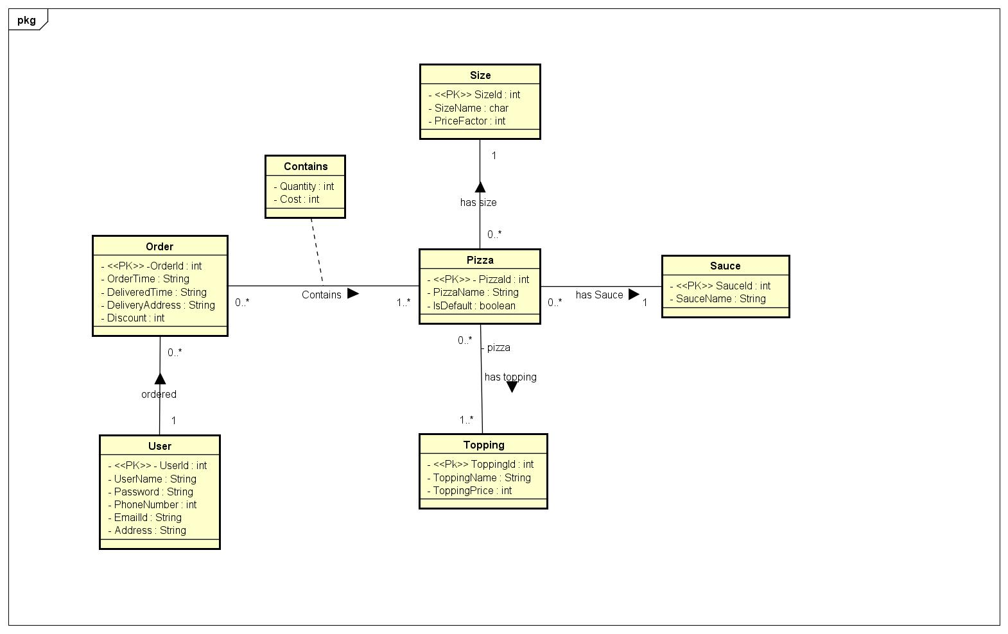
UML
Classes - 6 Association - 5 Many-to-many relations - 2

Slide 3
UML RM
User(UserId,UserName,Password,PhoneNo,Email,Street,ZipCode,City,State)
Pizza(PizzaId,PizzaName,IsDefault,SauceId,SizeId)
Size(SizeId,SizeName,PriceFactor)
Topping(ToppingId,ToppingName,ToppingPrice)
Sauce(SauceId,SauceName)
Order(OrderId,OrderTime,DeliveryTime,DeliveryAddress,UserId)
Contains(OrderId,PizzaId,Quantity,Cost)
hasTopping(PizzaId,ToppingId)
Tables - 8 (6(classes)+2(many-to-many)) Foreign Keys - 7 (5(association)+2(many-to-many))

Slide 4
BCNF
Functional Dependencies :
UserId -> UserName ,Password, PhoneNo, Email, Street,ZipCode,City, State
ZipCode->City, State
OrderId -> OrderTime,DeliveryTime,DeliveryAddress,UserId,Discount
OrderId,PizzaId->Quantity,SizeId,SauceId,Cost
PizzaId -> PizzaName,IsDefault
ToppingId->ToppingPrice,ToppingName
SizeId->PriceFactor,SizeName
SauceId->SauceName

Slide 5
userID, UserName ,Password, PhoneNo, Email, Street,ZipCode,City, State,OrderId,OrderTime, DeliveryTime, DeliveryAddress, Quantity, SizeId, SauceId, Cost,PizzaId,PizzaName ,ToppingPrice , ToppingName ,PriceFactor, Sizename ,SauceId ,SauceName
UserId -> UserName ,Password, PhoneNo, Email, Street,ZipCode,City, State
UserID, UserName ,Password, PhoneNo, Email, Street,ZipCode,City, State,
userID,OrderId,OrderTime, DeliveryTime, DeliveryAddress, Quantity, SizeId, SauceId, Cost,PizzaId,PizzaName ,ToppingPrice , ToppingName ,PriceFactor, Sizename ,SauceId ,SauceName
ZipCode->City, State
OrderId -> OrderTime,DeliveryTime,DeliveryAddress,UserId,discount
Continued..
ZipCode,City, State
userID, UserName ,Password, PhoneNo, Email, Street,Zipcode

Slide 6
OrderId -> OrderTime,DeliveryTime,DeliveryAddress,UserId,discount
PizzaId,Quantity,PizzaName, ToppingId,SizeId, SauceId,ToppingPrice , ToppingName ,PriceFactor, SizeName,Cost,IsDefault,OrderId,SauceName
OrderId,OrderTime,
DeliveryTime,
DeliveryAddress,
UserId,Discount
PizzaId -> PizzaName,IsDefault
PizzaId,PizzaName,
IsDefault
PizzaId,Quantity,ToppingId,SizeId,SauceId,ToppingPrice , ToppingName ,PriceFactor, SizeName,Cost,OrderId,SauceName
ToppingID->ToppingPrice,ToppingName
Continued..

Slide 7
ToppingID->ToppingPrice,ToppingName
ToppingId,
ToppingPrice,
ToppingName
PizzaId,Quantity,SizeId,SauceId,PriceFactor, SizeName,Cost,OrderId,SauceName,SizeName
SizeId->PriceFactor,SizeName
SizeId,SizeName,PriceFactor
PizzaId,Quantity,SauceId,Cost,OrderId,SauceName
SauceId->SauceName
sauceId,SauceName
PizzaId,Quantity,SauceId,Cost, OrderId,SauceName
OrderId,PizzaId-> Quantity,SauceId,SizeId,Cost
OrderID,PizzaID,Quantity, SauceId,SizeId
PizzaId,OrderID, ToppingID

Slide 8
Tables from BCNF
UserID, UserName ,Password, PhoneNo, Email, Street,Zipcode
ZipCode,City, State
OrderId,OrderTime,DeliveryTime,DeliveryAddress,UserId,Discount
PizzaId,PizzaName,IsDefault
ToppingId,ToppingPrice,ToppingName
SizeId,SizeName,PriceFactor
SauceId,SauceName
OrderID,PizzaID,Quantity, SauceId,SizeId
PizzaId,OrderID, ToppingID
Tables - 9

Slide 9
FDs for 3NF Synthesis
UserId -> UserName ,Password, PhoneNo, Email, Street,ZipCode,City, State
ZipCode->City, State
OrderId -> OrderTime,DeliveryTime,DeliveryAddress,UserId,Discount
OrderId,PizzaId->Quantity,SizeId,SauceId,Cost
PizzaId -> PizzaName,IsDefault
ToppingId->ToppingPrice,ToppingName
SizeId->PriceFactor,SizeName
SauceId->SauceName

Slide 10
3NF Synthesis-
Make all right hand side singleton-
UserID -> UserName OrderId,PizzaId -> Quantity
UserID -> Password OrderId,PizzaId -> SizeId
UserID -> PhoneNo OrderId, PizzaId -> SauceId
UserID ->Email OrderId,PizzaId -> Cost
UserID ->Street PizzaId->PizzaName
UserID ->ZipCode ToppingId->ToppingPrice
UserID ->City ToppingId->ToppingName
UserID ->State SizeId->PriceFactor
ZipCode->City SizeId->SizeName
ZipCode->State SauceId->SauceName
OrderId->OrderTime PizzaId->isDefault
OrderId->DeliveryTime
OrderId->DeliveryAddress
OrderId->UserId,

Slide 11
3NF Synthesis-
Remove extraneous left hand side
No extraneous found
Remove Redundant FD’s
UserID -> UserName OrderId->DeliveryAddress PizzaId->PizzaName
UserID -> Password OrderId->UserId PizzaId->isDefault
UserID -> PhoneNo OrderId,PizzaId -> Quantity SauceId->SauceName
UserID ->Email OrderId,PizzaId -> SizeId
UserID ->Street OrderId, PizzaId -> SauceId
UserID ->ZipCode OrderId,PizzaId -> Cost
ZipCode->City ToppingId->ToppingPrice
ZipCode->State ToppingId->ToppingName
OrderId->OrderTime SizeId->SizeName
OrderId->DeliveryTime SizeId->PriceFactor
Redundant FD’s UserID ->City UserID ->State

Slide 12
3NF Synthesis-
Merge All FD’s with same LHS
UserID -> UserName ,Password, PhoneNo, Email, Street, ZipCode.
ZipCode->City, State
OrderId->OrderTime, DeliveryTime, DeliveryAddress,UserId
OrderId,PizzaId -> Quantity, SizeId, SauceId, Cost
PizzaId->PizzaName ,ToppingPrice , ToppingName
SizeId->PriceFactor, SizeName
ToppingId -> ToppingName, ToppingPrice
SauceId ->SauceName

Slide 13
3NF Synthesis-
Form tables from FD’s
UserID,UserName ,Password, PhoneNo, Email, Street, ZipCode.
ZipCode,City, State
OrderId,OrderTime, DeliveryTime, DeliveryAddress,UserId
OrderId,PizzaId,Quantity, SizeId, SauceId, Cost
PizzaId,PizzaName
ToppingId,ToppingPrice , ToppingName
SizeId,PriceFactor,SizeName
SauceId,SauceName
ToppingId,PizzaId,OrderId - Global Key
Tables - 9

Slide 14
Tools
Bootstrap 3.3.7
Spring Boot 1.5.8
MySQL 5.7
Jasypt (Java Simplified Encryption) 1.9.2 - It uses the byte (binary) encryption mechanisms as a basis for text encryption.All the String results (of encryption) are encoded in hexadecimal, and thus can be safely stored as US-ASCII characters.

